Slide 1




Implementation of
Machine Learning
in
Credit Risk Analysis:
Predicting Potential
Customer Defaults
Presentation - 2025
Presented by:
Novan Rizki Wicaksono

Slide 2


Company Profile
id/x partners was established in 2002 by ex-bankers and management consultants who have vast experiences in credit cycle and process management, scoring development, and performance management. Our combined experience has served corporations across Asia and Australia regions and in multiple industries, specifically financial services, telecommunications, manufacturing and retail.
id/x partners provides consulting services that specializes in utilizing data analytic and decisioning (DAD) solutions combined with an integrated risk management and marketing discipline to help clients optimize the portfolio profitability and business process.

Slide 3


About Me
Hello, Im
EDA
Recommendation
Novan
Business Problem
ML Modeling
An Data Analyst enthusiast who is passionate about turning data into meaningful insights. With a background in accounting, I have skills in SQL, statistics, Excel, and data visualization (Tableau/Power BI)

Slide 4

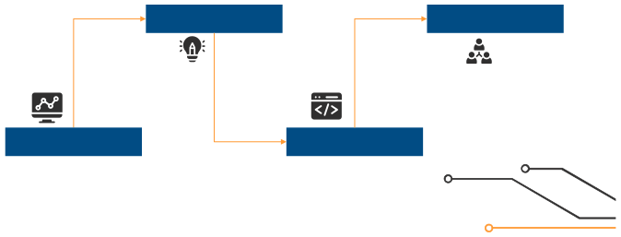
Outline
Dataset Overview and Business Insights
Business Advice for Improving Credit Risk
EDA
Recommendation
Business Problem
ML Modeling
Background and
Objective of Classification
Pre-processing and
Model Comparison

Slide 5

Business Problem
. . .

Slide 6




Background
Credit risk is a crucial element that needs to be understood by financial institutions and loan service providers. To optimize the management of this risk, finance companies continue to strive to improve creditworthiness assessment methods. Approving loans to borrowers with a high risk of default can have a negative impact on the company's financial performance, and errors in transmitting credit risk have the potential to have serious consequences.
In the world of finance, a suboptimal credit granting process and inappropriate credit risk management can result in major losses. By applying machine learning algorithms to analyze large amounts of historical data, financial institutions can uncover patterns and trends that are difficult for human analysts to detect. This allows for more accurate credit decision making and more efficient risk management, thereby minimizing potential losses due to inappropriate credit granting.
Therefore, the development of a machine learning model that is able to predict potential defaults based on factors such as the customer's economic and financial conditions is very important to avoid losses due to bad debts.

Slide 7



Objective of
Classification
1
Problem Statement
11% of 460k customers still in default
2
Goal
Reduce the number of customers who default on loans by increasing the accuracy of credit risk assessment using machine learning by at least 20%.
3
Objective
Classify potentially default customers using machine learning.
4
Business Metrics
The accuracy in forecasting whether a loan applicant or customer is likely to default on their credit payment or fulfill it as scheduled.

Slide 8

After understanding the background and purpose of the classification process, it is crucial to perform data exploration (EDA) to gain deeper insights.
EDA helps in recognizing important variables, discovering hidden patterns, and detecting anomalies in the data that could potentially affect the performance of the classification model. This will support the development of a more accurate and optimized model.

Slide 9
Exploratory Data Analysis
. . .

Slide 10


Features
Description
Dataset Overview
id member_id loan_amnt funded_amnt term int_rate installment
Unique identification for each loan.
Unique identification for each customer.
The amount of loan requested by the customer.
The amount of loan approved and funded by the lender.
The loan term in months.
The annual interest rate given on the loan.
The monthly payment amount that must be paid by the
customer.
grade
emp_length
loan_status
pymnt_plan
total_pymnt
last_pymnt_d
The credit quality level of the customer given by the lender.
The length of time the customer has been employed in years.
The current status of the loan. (e.g. fully paid, default, etc.)
Indicator whether the customer has a payment plan.
The total amount of payments made by the customer to date.
The date of the last payment made by the customer.
recoveries
The amount of money successfully recovered by the lender after the loan is considered in default.
Other features.
etc.
Number of Rows
466,285
Dataset source: LINK

Slide 11
Before proceeding to the predictive model building stage, it is important to first conduct exploratory data analysis to gain a deep understanding of the historical data.
This helps companies make more informed decisions when designing models, so that the resulting models are more accurate and based on reliable insights.

Slide 12
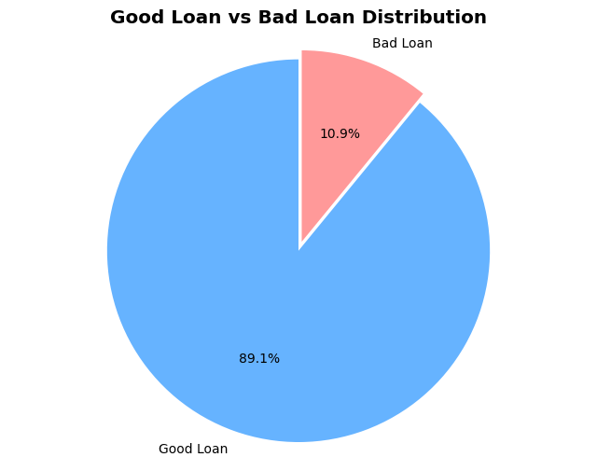


Insight Visualization
1
Based on the figure above, the distribution between Good Loan and Bad Loan can be seen in the form of a pie chart:
Good Loan (current loan) dominates with a proportion of 89.1%.
Meanwhile, Bad Loan (non-performing loans) only covers 10.9% of the total data.
2
This visualization shows that the dataset is imbalanced, where the majority of loans are classified as current. This is important to note when building predictive models, as class imbalance can affect model performance - particularly in detecting the minority category (Bad Loan), which is often the main focus of credit risk analysis. Approaches such as oversampling, undersampling, or the use of appropriate evaluation metrics (such as F1-score, AUC) need to be considered so that the model is not biased towards the majority of the class.

Slide 13
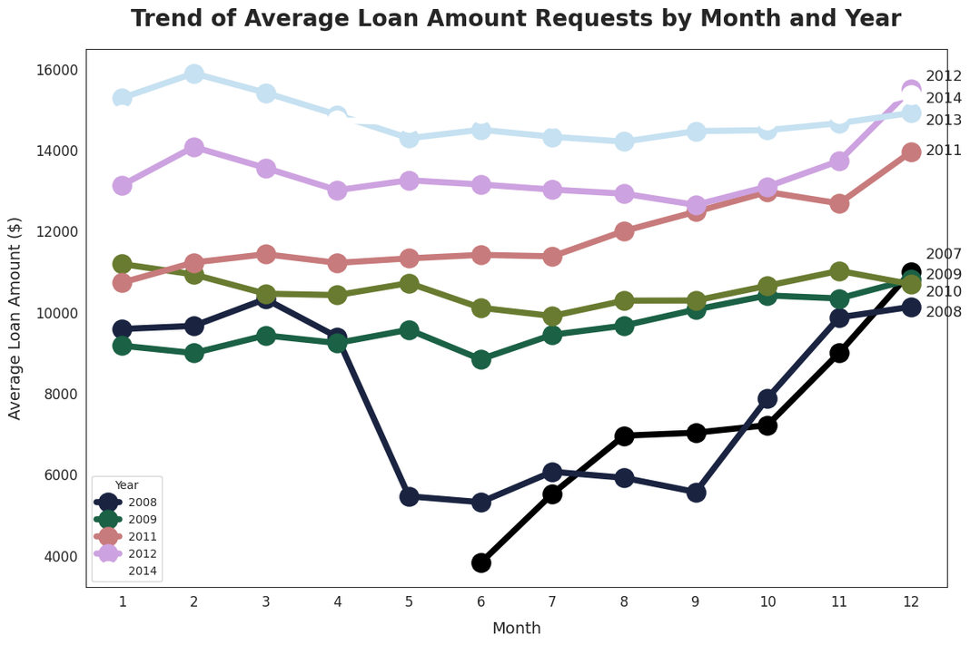

Insight Visualization
1
Based on the annual trend of demand for the average loan amount, it can be seen that the average loan amount has generally increased from year to year, although there are fluctuations in certain months.
2
The increase in the average number of loans is particularly noticeable from 2011 to 2014, which indicates that the demand for loans tends to be greater each year. This could be an indication that people have more confidence in lending institutions, but it could also lead to a potential increase in credit risk if not accompanied by rigorous feasibility analysis.
3
The sharp decline in average loan amounts is particularly pronounced from May to August, especially in years such as 2008 and 2009, which could reflect either economic conditions affecting borrowers' ability to borrow or stringent lending requirements in those months.
4
Average loans tend to rise again at the end of the year (October-December), especially in earlier years such as 2008-2010, which could indicate a need for additional funds towards the end of the year, such as for seasonal consumption or repayment of obligations.

Slide 14
Implication
1
The Company should increase vigilance and selectivity in lending from May to August, especially to segments with high risk profiles, to prevent a spike in bad debts.
2
A more adaptive and dynamic risk management strategy is needed to follow seasonal demand patterns, as well as strengthening the credit scoring system to be able to adjust to specific month and year conditions.
3
In addition, historical analysis such as this needs to be utilized to map trends and forecast potential pressure on the quality of the loan portfolio in the future.
4

Slide 15
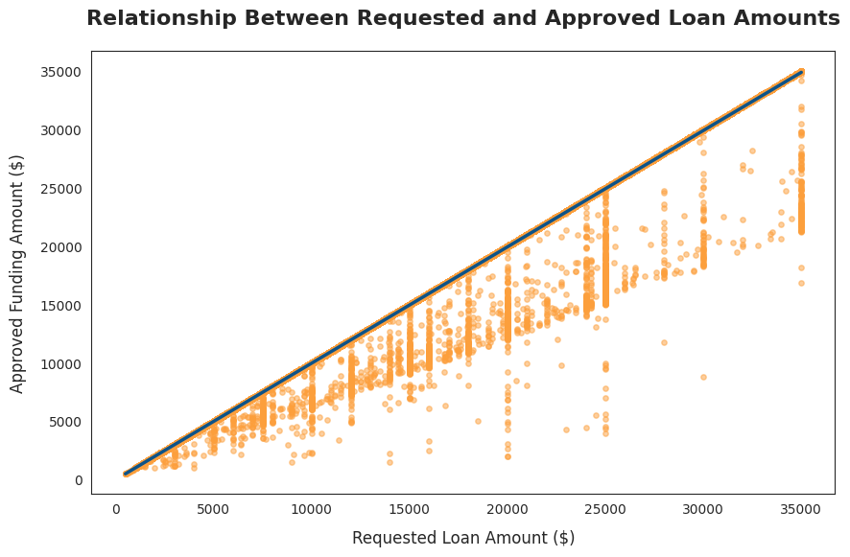
Insight Visualization
.
The very strong correlation between requested loan amount and approved funding amount suggests that companies tend to approve loan requests according to the amount proposed by the borrower.
.
However, there are a number of outliers that show significant differences between the requested and approved amounts. This indicates that not all requests are fulfilled in full, possibly due to factors such as low credit score, poor repayment history, or high default risk.
.
The pattern shows that the larger the loan amount requested, generally the larger the amount approved, albeit with higher variation for large loan values. This information is useful for companies to strategize loan offers that are more scalable and in line with funding capacity.
.
If it is found that many high-value loan requests are not approved in full, then this is an important indication for the company to review its creditworthiness policy. The company may consider refining its credit risk assessment model or developing loan products with more realistic credit limits for certain market segments.

Slide 16
Implication
.
Companies are advised to continuously monitor the gap between loan requests and approvals, especially at high nominal values, in order to not lose potential customers.
.
Increased transparency and communication regarding loan terms and conditions is also important, so that customers have realistic expectations regarding the amount of loans they can receive.
.
Companies can design special loan products with a certain maximum limit for the medium-risk customer segment, so that they can still channel funds safely.
.
A more in-depth risk analysis using historical data should be implemented to anticipate the possibility of default, especially on high-value loan requests.
.
Providing potential borrowers with a clear understanding of the factors that affect the loan amount approved can build trust and reduce customer dissatisfaction.

Slide 17
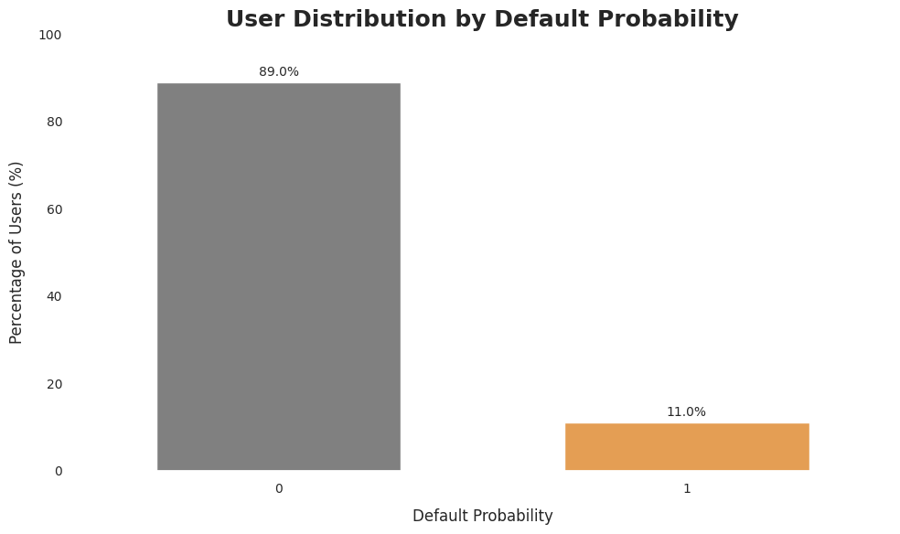
Insight Visualization
.
The default rate of 11% indicates that the credit risk in the company's portfolio is still quite high, so it is necessary to take steps to mitigate and improve lending policies.
.
On the other hand, the non-default rate of 89% reflects that the company has successfully maintained the overall quality of its loan portfolio, indicating that most lending decisions have been made quite prudently.
.
If the company targets dropping the default rate to 10%, then at least 1% of the user population needs to be screened or re-managed.
.
Further reductions should consider the balance between risk management and business growth.

Slide 18
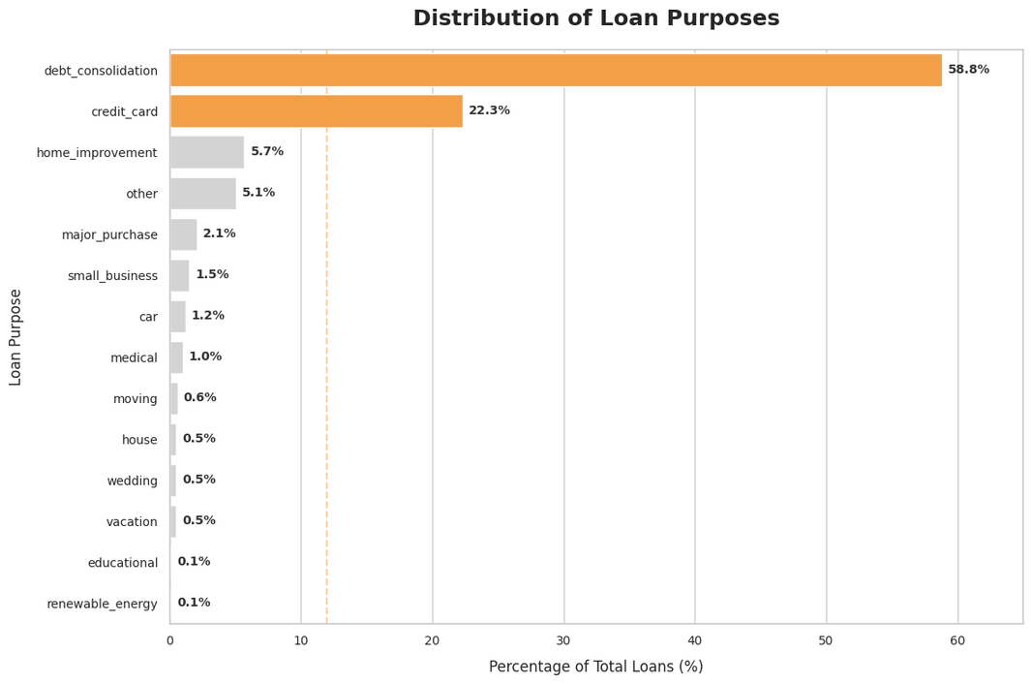
Insight Visualization
.
The most common loan purposes used by customers were debt consolidation at 58.8% and credit card repayment at 22.3%. This figure shows that more than 80% of the total loan was given to solve personal financial problems, mainly in the form of debt repayment.
.
This reflects that the majority of customers are in a financial situation that requires rearrangement, and they use loans as a tool to restructure existing debt.
.
This also indicates that lending companies need to be aware of the potential risk of default, especially from the segment of customers who take out loans to pay off previous debts.
.
Therefore, companies can develop support services such as financial counseling, personal finance management education, or debt management programs. In addition to reducing credit risk, this step can also enhance long-term relationships with customers and create greater trust in the company.

Slide 19
Insight Visualization
.
The most common loan purposes used by customers were debt consolidation at 58.8% and credit card repayment at 22.3%. This figure shows that more than 80% of the total loan was given to solve personal financial problems, mainly in the form of debt repayment.
.
This reflects that the majority of customers are in a financial situation that requires rearrangement, and they use loans as a tool to restructure existing debt.
.
This also indicates that lending companies need to be aware of the potential risk of default, especially from the segment of customers who take out loans to pay off previous debts.
.
Therefore, companies can develop support services such as financial counseling, personal finance management education, or debt management programs. In addition to reducing credit risk, this step can also enhance long-term relationships with customers and create greater trust in the company.

Slide 20
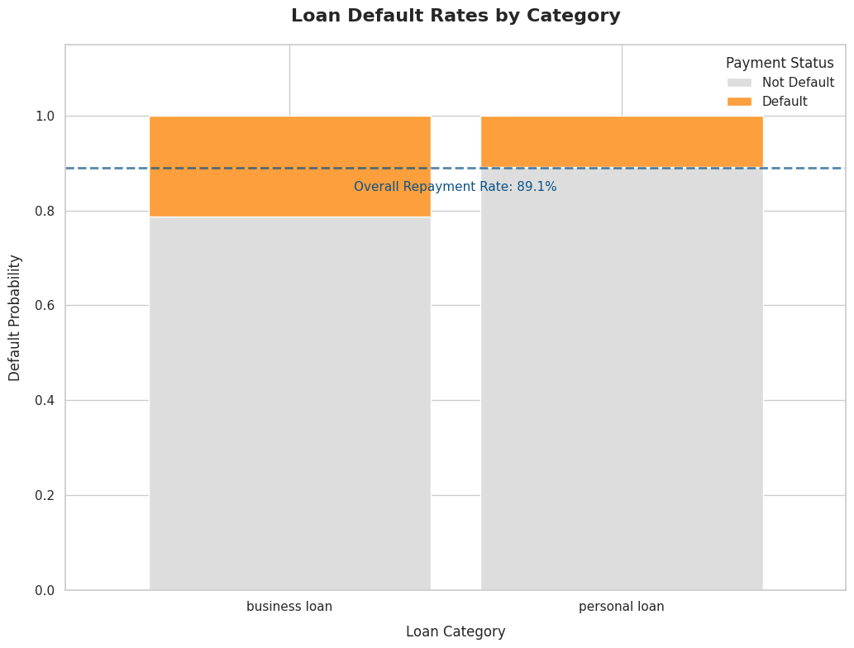
Insight Visualization
.
Business loans category is slightly higher than that for personal loans, with the overall average repayment rate standing at 89.1%. This means that while most borrowers continue to repay on time, there is a tendency for business purpose borrowers to be more at risk of default.
.
Personal loans show a slightly higher repayment rate, indicating that borrowers in this category tend to be more financially stable or have more predictable cash flows. Business loans may carry more risk as they depend on fluctuations in business or business income, which is more volatile than individual income.
.
By identifying these patterns, companies can take a risk-based approach in the underwriting process. A more in-depth assessment of business capacity, track record, and growth potential can help mitigate default risk.
.
In addition, it is important for companies to actively monitor business loan performance on a regular basis and provide additional support such as business management counseling or loan restructuring programs for struggling businesses.

Slide 21
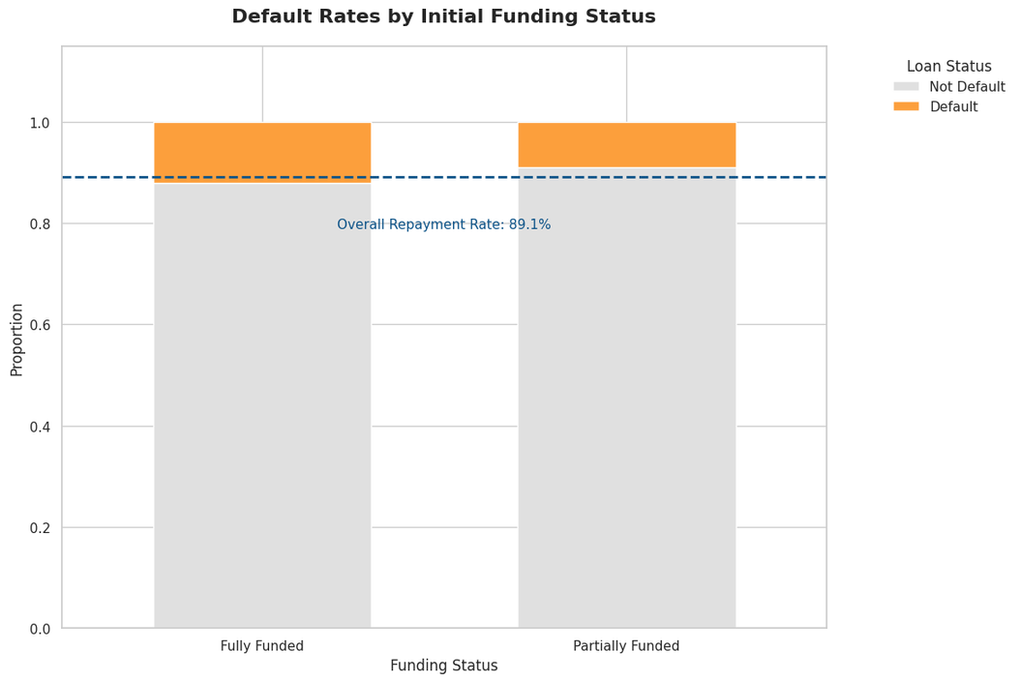
Insight Visualization
.
Default rate is slightly higher on fully funded loans compared to partially funded loans. Both categories have repayment rates close to the overall average of around 89.1%, but partially funded loans appear to be slightly more reliable.
.
This indicates that customers who are not fully funded tend to be more reliable in making repayments than those who receive full funding.
.
One possible reason for this is that not fully funded customers may have a better risk profile, such as a higher credit score or a more solid repayment history, so investors are more selective in providing partial funding.
.
Although the loan amount received by non-full-funded customers is smaller, this may motivate them to be more disciplined in repayment, as the payment burden tends to be lighter.

Slide 22
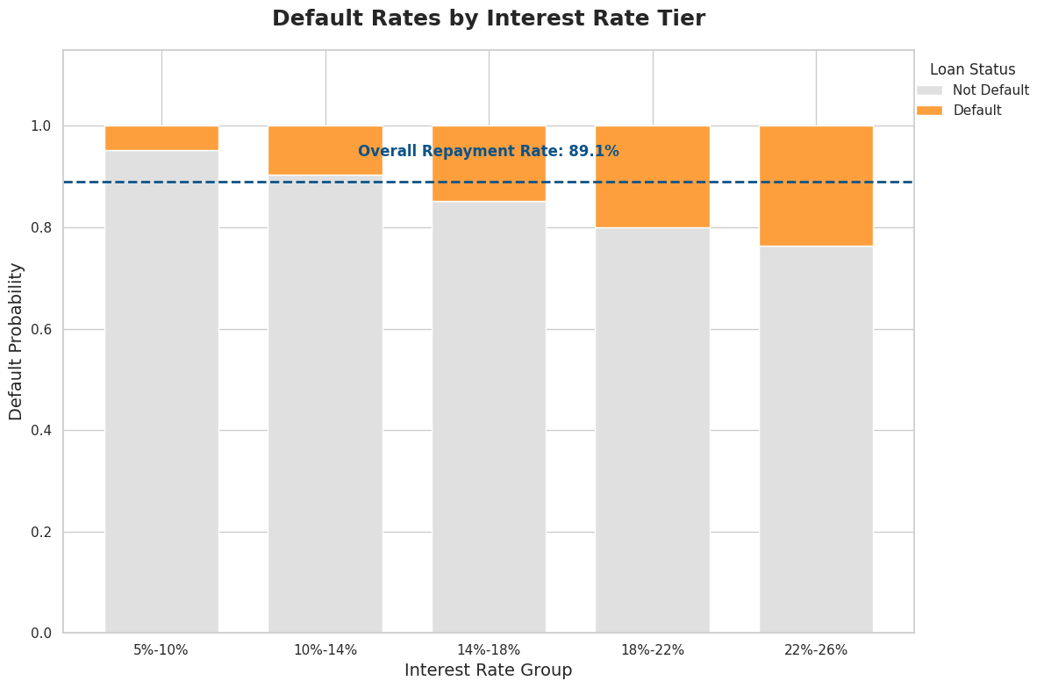
Insight Visualization
.
Default rates increased along with the increase in interest rates, especially in the interest rate above 14% group. Loans with interest rates of 22%-26% have the highest default rate, well above the average repayment rate of 89.1%.
.
This indicates that customers with high-interest loans are more at risk of delay or default, compared to customers with low interest rates.
.
Increased interest rates are usually associated with higher credit risk assessment, so the higher the interest rate, the more likely it is that the borrower is classified as financially high risk.
.
In practice, an increased interest burden makes monthly installments heavier, which in turn reduces the customer's ability to pay on time.

Slide 23
Based on the insights that have been gained, it is known that several variables such as loan amount, intended use of funds, repayment performance, and interest rate play a role in influencing customer default risk.
However, there are still many other factors that can potentially affect default rates and can be analyzed more deeply using a machine learning approach.
Therefore, the application of machine learning techniques is crucial for companies to gain a more thorough understanding of the causes of default and to improve the accuracy of decision-making in business activities.

Slide 24
Machine Learning Modelling
. . .

Slide 25





Why Using Machine Learning
Reduce Cost
Accurate
Automatic classification saves time and money compared to the manual or hands-on credit risk analysis process.
Machine learning algorithms are able to analyze data patterns and provide predictions of credit risk levels with high accuracy.
Automated System
Minimize Human Error
The classification process can be run automatically on data that is large in scale and has a high level of complexity.
Mitigate errors caused by human factors when predicting credit risk.

Slide 26
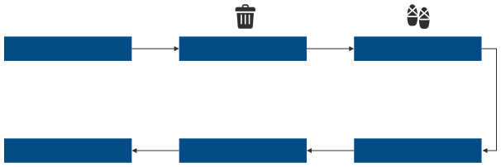




Data Preprocessing
Raw Data
Drop Missing Values
Duplicated Data
Check
The original data consists of 466,285 rows of data.
Removes a number of columns that contain unique, empty, or constant values ​​entirely.
The data set does not contain duplicate data.
Pre-Processing
Handling
Missing Values
Feature Engineering
Splitting the data into training set and test set, converting categorical variables using one-hot encoding, standardizing numeric features, and handling class synchronization with undersampling techniques.
Filling empty cells using 0 or -1 considering that these numbers are outside the existing distribution pattern.
Perform data type conversion on multiple columns and filter outliers across multiple columns using manual methods based on specific considerations.

Slide 27

Workflow
Modeling Without Hyperparameter Tuning
Hyperparameter Tuning
Comparison of Tuned Models and Model Evaluation
Implementing 6 different machine learning algorithms (logistic regression, decision trees, random forests, Adaboost, XGBoost, and LGBM) to run predictive models.
Optimizing model performance through cross-validation and hyperparameter tuning processes on each applied machine learning algorithm.
Compile a summary evaluation matrix of all algorithms, determine the model with the best performance, and perform further evaluation using the Kolmogorov-Smirnov method.

Slide 28
The initial code was run without hyperparameters, followed by cross-validation to obtain baseline performance.
Next, hyperparameter tuning was performed on the models and a comparative analysis of the results was performed.
Please check the code on the following link:
LINK

Slide 29
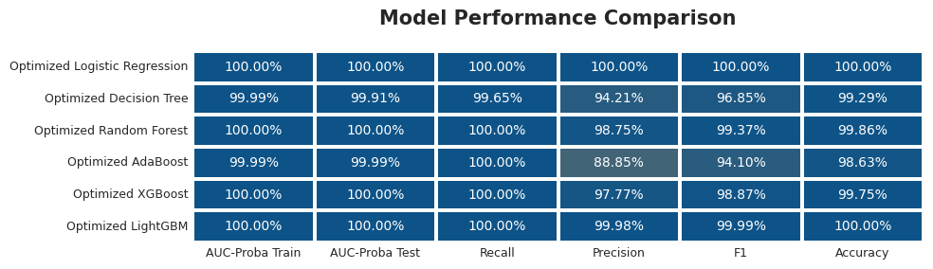


Model Performance Comparison
1
After the XGBoost model training process was carried out, the model performance on data validation showed very good results with AUC metrics of 85.23%, precision of 78.12%, recall of 92.34%, and F1-score of 87.65%.
3
The fairly high precision also indicates that most of the default predictions given by the model are correct, so the potential for false positives can be suppressed.
The high recall value indicates that the model is very effective in recognizing default cases, which is important in the context of credit risk management.
These results strengthen the decision to select XGBoost as the final model, and support further analysis such as feature importance and SHAP to determine the variables that have the most influence on credit risk prediction.
2
4

Slide 30
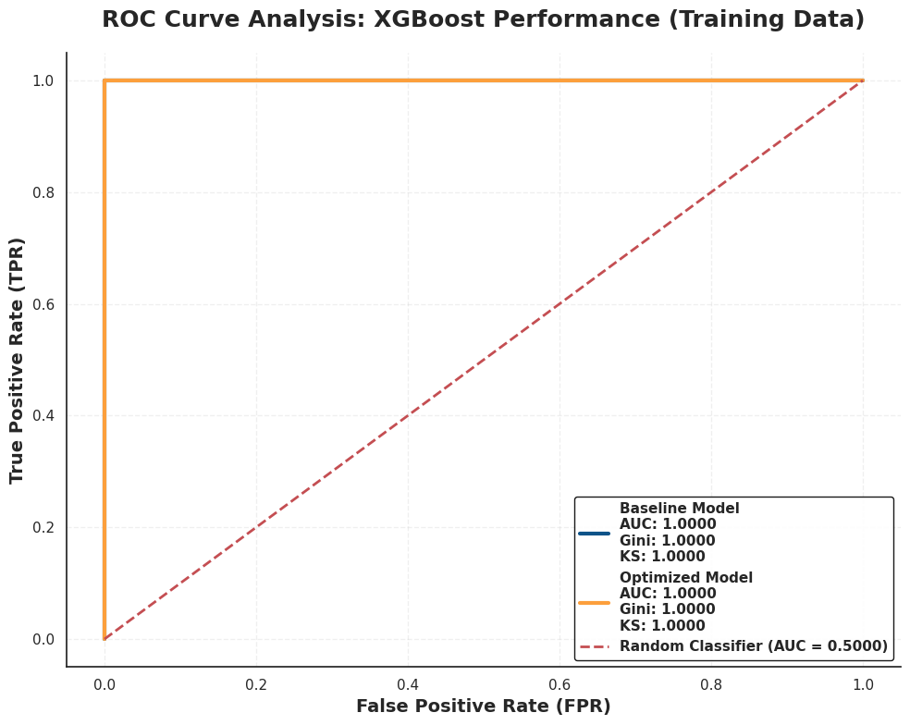
1
Curve
Kolmogorov-Smirnov
The ROC curve shows the performance of the XGBoost model after training on the training data, where the AUC, Gini, and KS values ​​reach their maximum (1,000) both on the baseline model and after optimization. This value indicates the perfect ability of the model to distinguish between default and non-default classes on the training data.
Preparing for the Future of Work
2
Model
This very high performance model could be an indication that the model is overfitting, that is, the model is too adjusted to the training data and risks not performing as well when tested on data that has never been seen.
3
Value
The KS value = 1,000, AUC = 1,000, and Gini = 1,000 indicate the very high discriminatory ability of the model on the training data, but it needs to be revalidated on the testing data to ensure that the model remains general and does not just memorize patterns in the training data.
4
Prevent Overfitting
To get a more objective evaluation, it is better to conduct an evaluation model using data validation/testing and techniques such as cross-validation and regularization. In the context of credit risk, a model with AUC above 0.7 and KS above 0.3 is considered good, but perfect values ​​like this need to be watched out for and further validated.

Slide 31
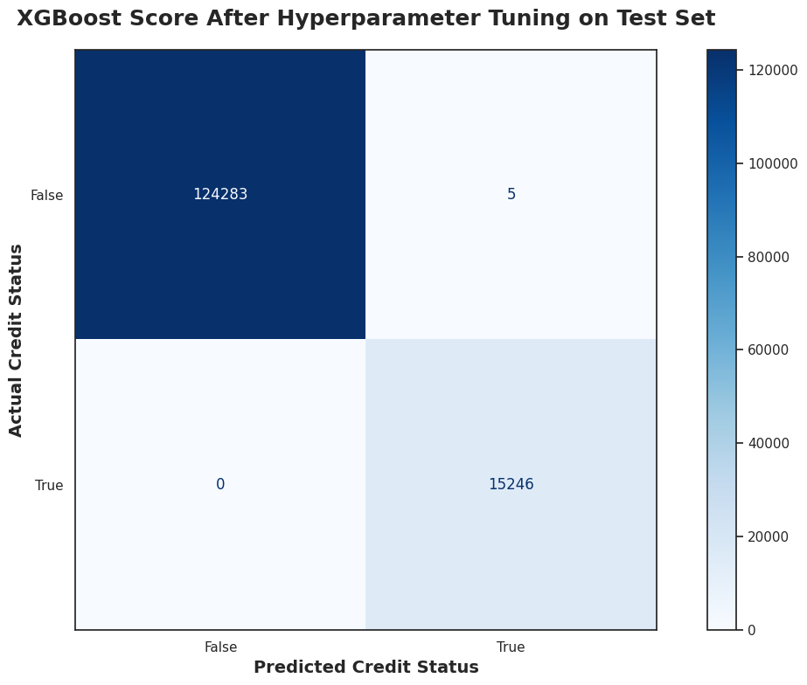
Curve
Dataset Test Evaluation
1
After hyperparameter tuning, the XGBoost model showed almost perfect prediction performance on the testing dataset. Based on the complexity matrix, the model successfully classified 15,246 customers who were truly at risk of default accurately (true positives) and 124,283 customers who were not at risk of default accurately (true negatives).
2
In the context of credit risk prediction, these results show that there were no customers who were actually at risk of default but were predicted as not at risk by the model (false negatives = 0), and there were only 5 cases where the model incorrectly predicted customers as at risk of default when they were not (false positives = 5).
3
This very low misclassification rate indicates that the model is very good at distinguishing between customers who are at risk and those who are not at risk of default.
4
Although these results are very impressive, additional evaluation is needed to ensure that the model does not experience overfitting, which is adjusting too much to the training or validation data so that it loses generalization when imagined on new data.

Slide 32
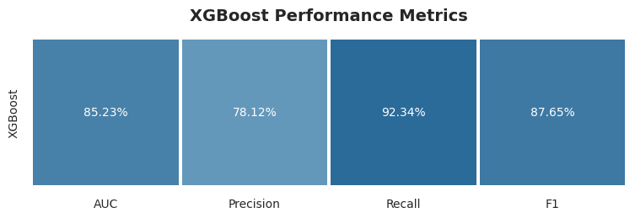
Final Model
1
After the XGBoost model training process was carried out, the model performance on data validation showed very good results with AUC metrics of 85.23%, precision of 78.12%, recall of 92.34%, and F1-score of 87.65%.
3
The fairly high precision also indicates that most of the default predictions given by the model are correct, so the potential for false positives can be suppressed.
The high recall value indicates that the model is very effective in recognizing default cases, which is important in the context of credit risk management.
These results strengthen the decision to select XGBoost as the final model, and support further analysis such as feature importance and SHAP to determine the variables that have the most influence on credit risk prediction.
2
4

Slide 33

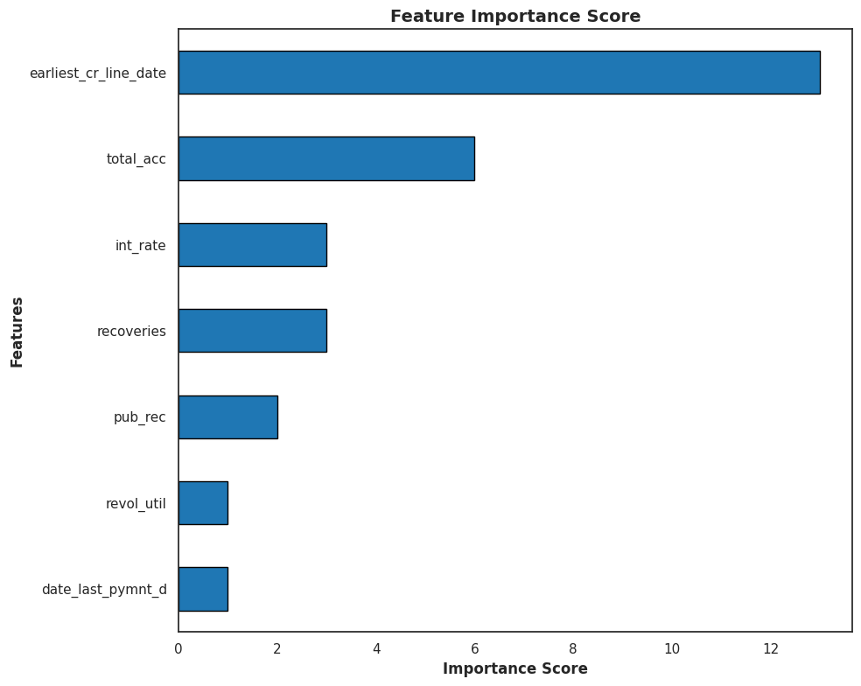
Feature Importance
After tuning the XGBoost model and analyzing the influential features, 7 main features were obtained that have the most significant contribution in predicting the risk of customer default:
early_cr_line_date and total_acc indicate the importance of credit history and the total number of credit accounts held.
int_rate, recovery, and pub_rec indicate that interest rate conditions, recovery amounts, and public records such as bankruptcy are also determining factors.
revol_util and date_last_pymnt_d refer to the revolving credit utilization ratio and the last payment date, which provide insight into recent payment patterns.
Based on these findings, lenders can emphasize risk assessment on credit history information and recent payment behavior. By considering these important features, companies can improve their risk management strategies and minimize potential losses from customer default.

Slide 34
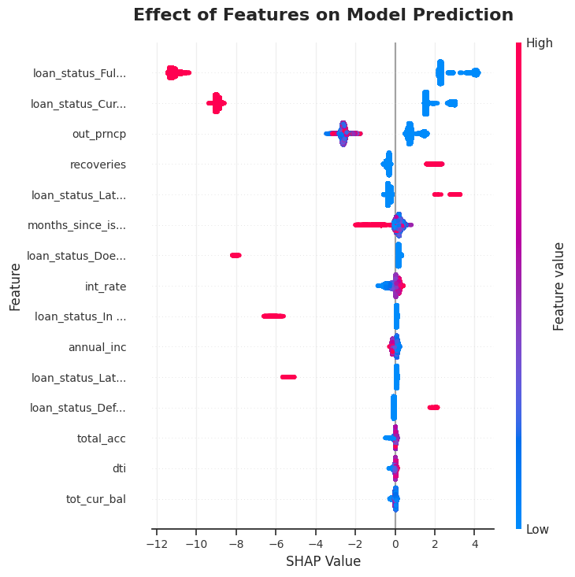
SHAP Values - 1
Loan Status (loan_status_Paid, loan_status_Current, etc.)
This feature shows that the previous loan status is very influential in predicting the risk of default.
Loans with fully paid and current status tend to reduce the risk of default, as seen from the negative SHAP value (positive effect on repayment).
Conversely, the late, in Grace Period, or default status shows a strong influence towards the prediction of default (positive SHAP).
out_prncp (High-Achieving Principal)
The higher the remaining principal that has not been paid, the greater the possibility of default.
recovery
The amount of funds that have been successfully promised from previous loans is also guaranteed by risk. A high value may indicate that the customer has previously experienced default.
months_since_issue_d
The longer the time since the loan was issued, the more likely it is to be associated with an increased risk of default.

Slide 35
SHAP Values - 2
int_rate (Interest Rate)
Similar to the first figure, high interest rates contribute to an increased risk of default.
annual_inc (Annual Income)
Low income (red SHAP dot on the right) increases the likelihood of default.
total_acc, dti, total_cur_bal
The total number of credit accounts, debt-to-income ratio, and total balances held by customers remain important indicators of repayment capacity.

Slide 36
Based on the analysis of the importance of features, it was found that variables related to the amount of the loan play an important role in determining the level of credit risk.
This finding allows me to provide more in-depth and reliable recommendations in assessing customer credit risk.

Slide 37
Recommendation
. . .

Slide 38




out_prncp
recoveries
annual_inc
Financial institutions or lenders are advised to strengthen their risk management systems by routinely monitoring the amount of remaining principal that has not been paid off by customers and considering preventive measures to reduce the potential risk of default.
When a customer is unable to repay their loan, the company can recover some of the funds through various efforts such as selling collateral or negotiating a settlement. However, it is important for companies not to rely too much on this recovery process. Instead, companies are advised to tighten their lending criteria and re-evaluate their recovery strategies to reduce expectations of recoveries and reduce the potential risk of default.
Companies are advised to provide a more flexible payment scheme for customers with low incomes. For example, by extending the loan tenor or setting a lower interest rate. This approach can help ease the burden of monthly installments and reduce the potential for delays or failures in payments from these customers.
int_rate
Companies should consider offering lower interest rates, especially to customers with high risk levels. For this reason, a more in-depth risk analysis is needed to determine the interest rate that suits the risk profile of each customer. In addition, companies can also provide incentives in the form of interest rate cuts for customers who have a good and consistent payment history. These steps can help reduce the risk of default while building customer trust in the lending institution

Slide 39




loan_status_Current
loan_status_Late
loan_status_Fully Paid
Customers with the status Fully Paid have a good history and can be used as a benchmark or reference in compiling a low-risk profile. The company can provide special offers for retention.
Customers with the status Current still need to be monitored for payment consistency. A periodic reminder or notification system can keep customers on time in paying
Implemented quick actions such as strong warnings, automatic reminders, or direct consultations when customers are in this late status.
months_since_issue_d
Analyzed default patterns based on loan age. For example, defaults are more common in the first 6 months, so extra monitoring during that period is crucial.

Slide 40




THANK YOU
FOR WATCHING
Contact Us
Novan Rizki Wicaksono
novanrw1611
novanrizki1234@gmail.com

